Slide 1
Week3
Bert & Swin Transformer

Slide 2
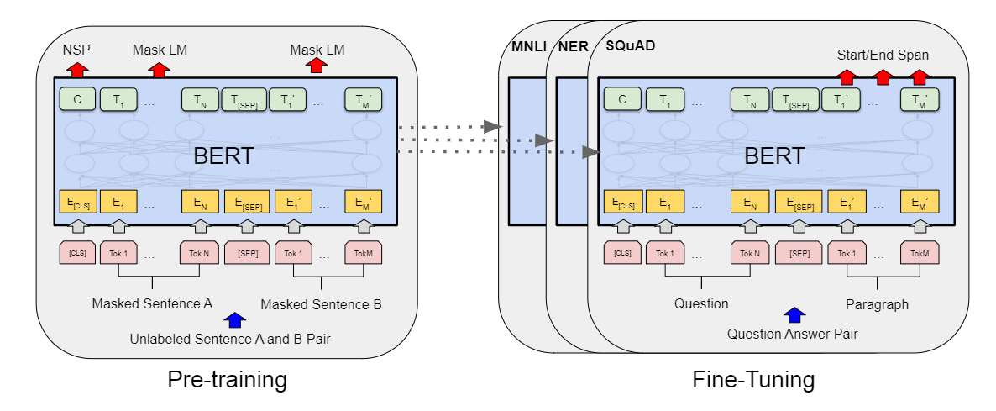
Bert
Architecture
Embedding
Bidirection

Slide 3
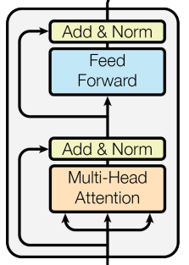
Architecture
output
Bert stack by Transformer Encoder Layer.
Pre-training on BooksCorpus and English Wikipedia with 2 task: Masked LM and Next Sentence Prediction
…
N layers
input

Slide 4
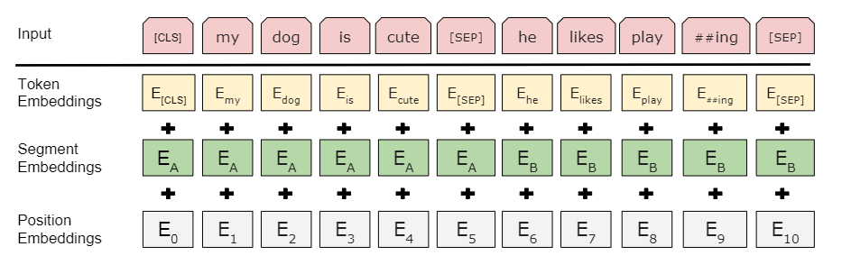
Embedding
All these Embeddings are implemented by linear layer, the input embeddings are the sum of these embeddings.

Slide 5
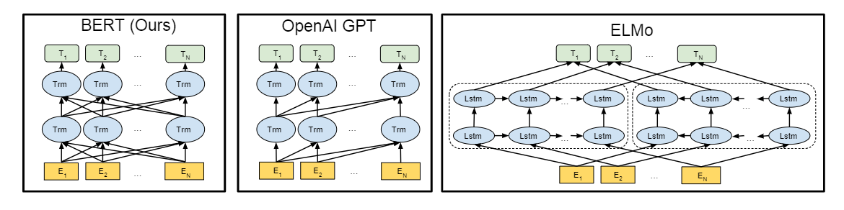
Bidirection
Different with OpenAI GPT and ELMo, Bert uses a bidirectional transformer, which the multi-head self attention use bidirectional message of input. OpenAI GPT uses a left-to-right transformer, ELMs uses the concatenation of left-to-right and right-to-left model

Slide 6
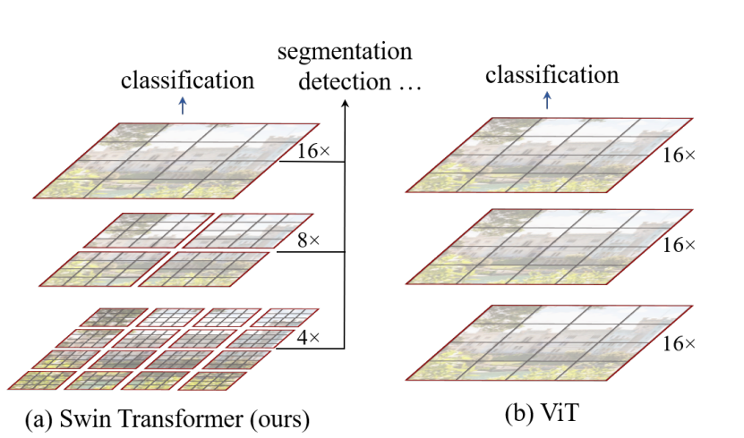
Swin Transformer
Architecture
Window-MSA
Shifted Window
Relative position bias

Slide 7
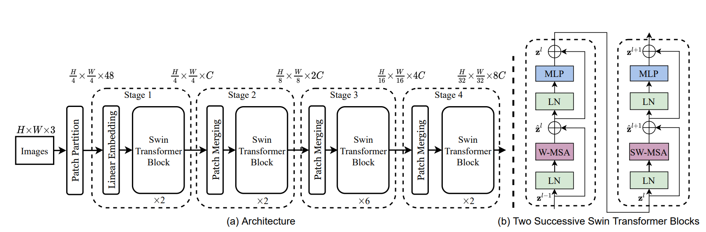
Architecture
Swin Transformer task by 4 stages, stage 1 stack by Linear Embedding and Swin Transformer Block(ST block), other stack by Patch Merging and ST block.
A ST block consist of 2 successive Transformer Encoder block, which alternate the MSA by W-MSA and SW-MSA.

Slide 8
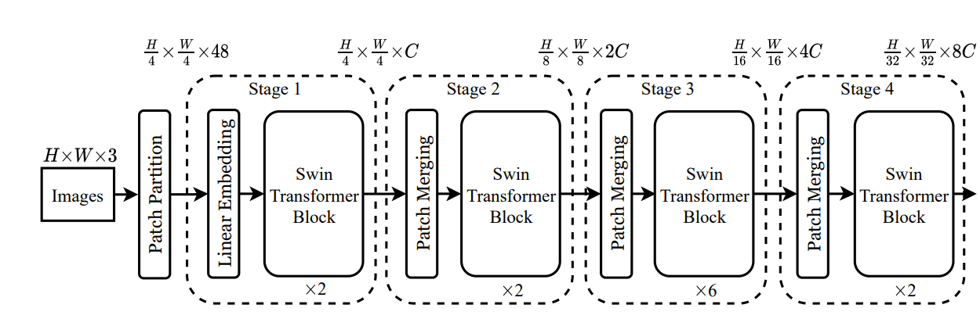
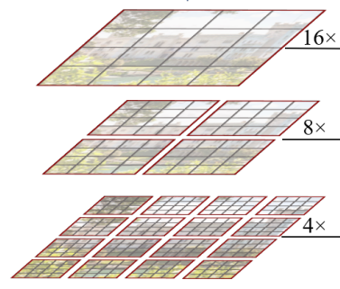
Window-MSA
Merging
Different from ViT and other visual Transformer, Swin Transformer uses the window self-attention to reduce the computing size, which just focus on local patch, and merging these patch on Patch Merging Layer after ST block to get global relation.
Gary means patch, Red means attention window

Slide 9
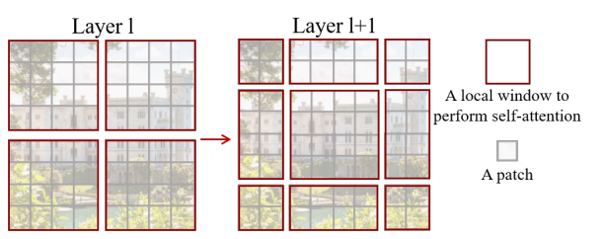
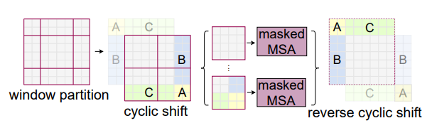
Shifted Window
For get information between neighboring window and reduce the computing size, Swin Transformer uses top-left cyclic shift on Shifted-Window-MSA after Window-MSA.
In Shifted-Window, only identical partition will be computing, different partition in same patch will be masked when computing self-attention.
Notes:
https://blog.csdn.net/weixin_42715977/article/details/124151870

Slide 10
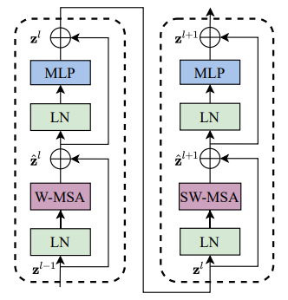

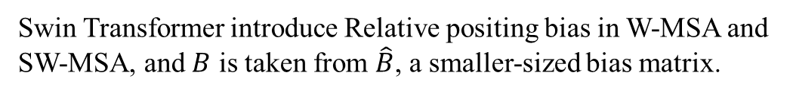
Relative position bias
Swin Transformer introduce Relative positing bias in W-MSA and SW-MSA, and $B$ is taken from $\hat{B}$, a smaller-sized bias matrix.
Notes:
https://blog.csdn.net/qq_37541097/article/details/121119988

